Slide 1
Seismic Network in Altay-Sayan
Altai-Sayan Branch of Geophysical Survey Siberian Branch of the RAS
Institute of Petroleum Geology and Geophysics SB RAS
A.Emanov, E.Leskova, D.Korabelshikov, V.Goncharov, I.Sychev, A.Durachenko

Slide 2
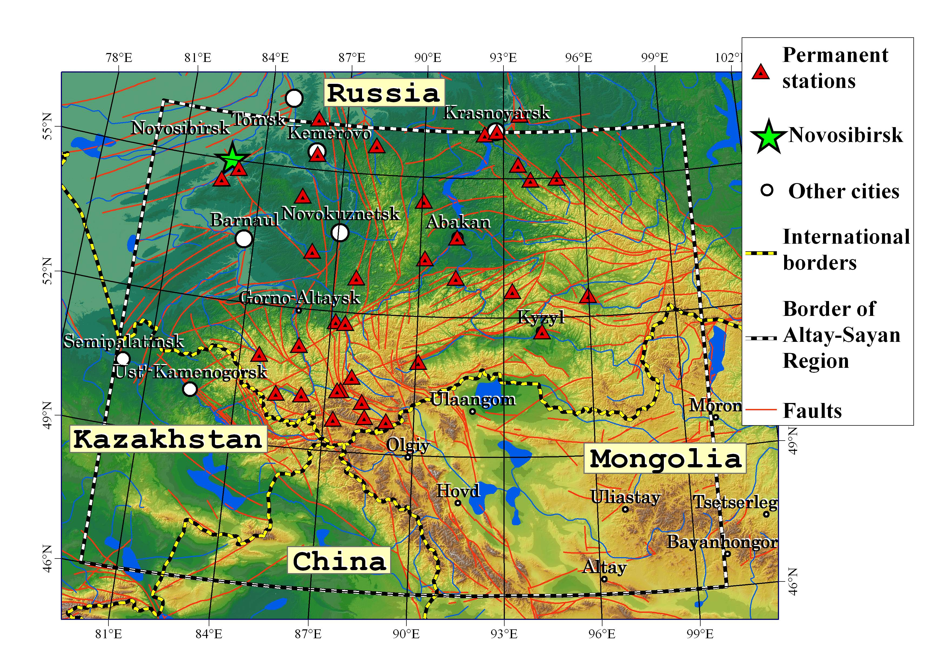
Altay-Sayan Seismic Network

Slide 3
Seismological Test Site more dense network
Altay Seismological
Test Site

Slide 4
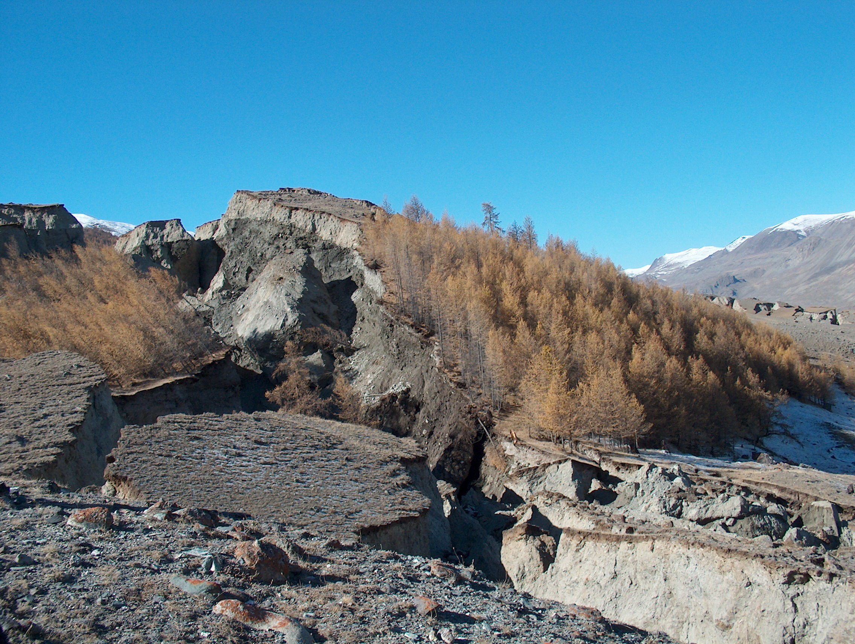
Chuy earthquake 27.09.2003 Ms= 7.3 (Mountain Altay)

Slide 5
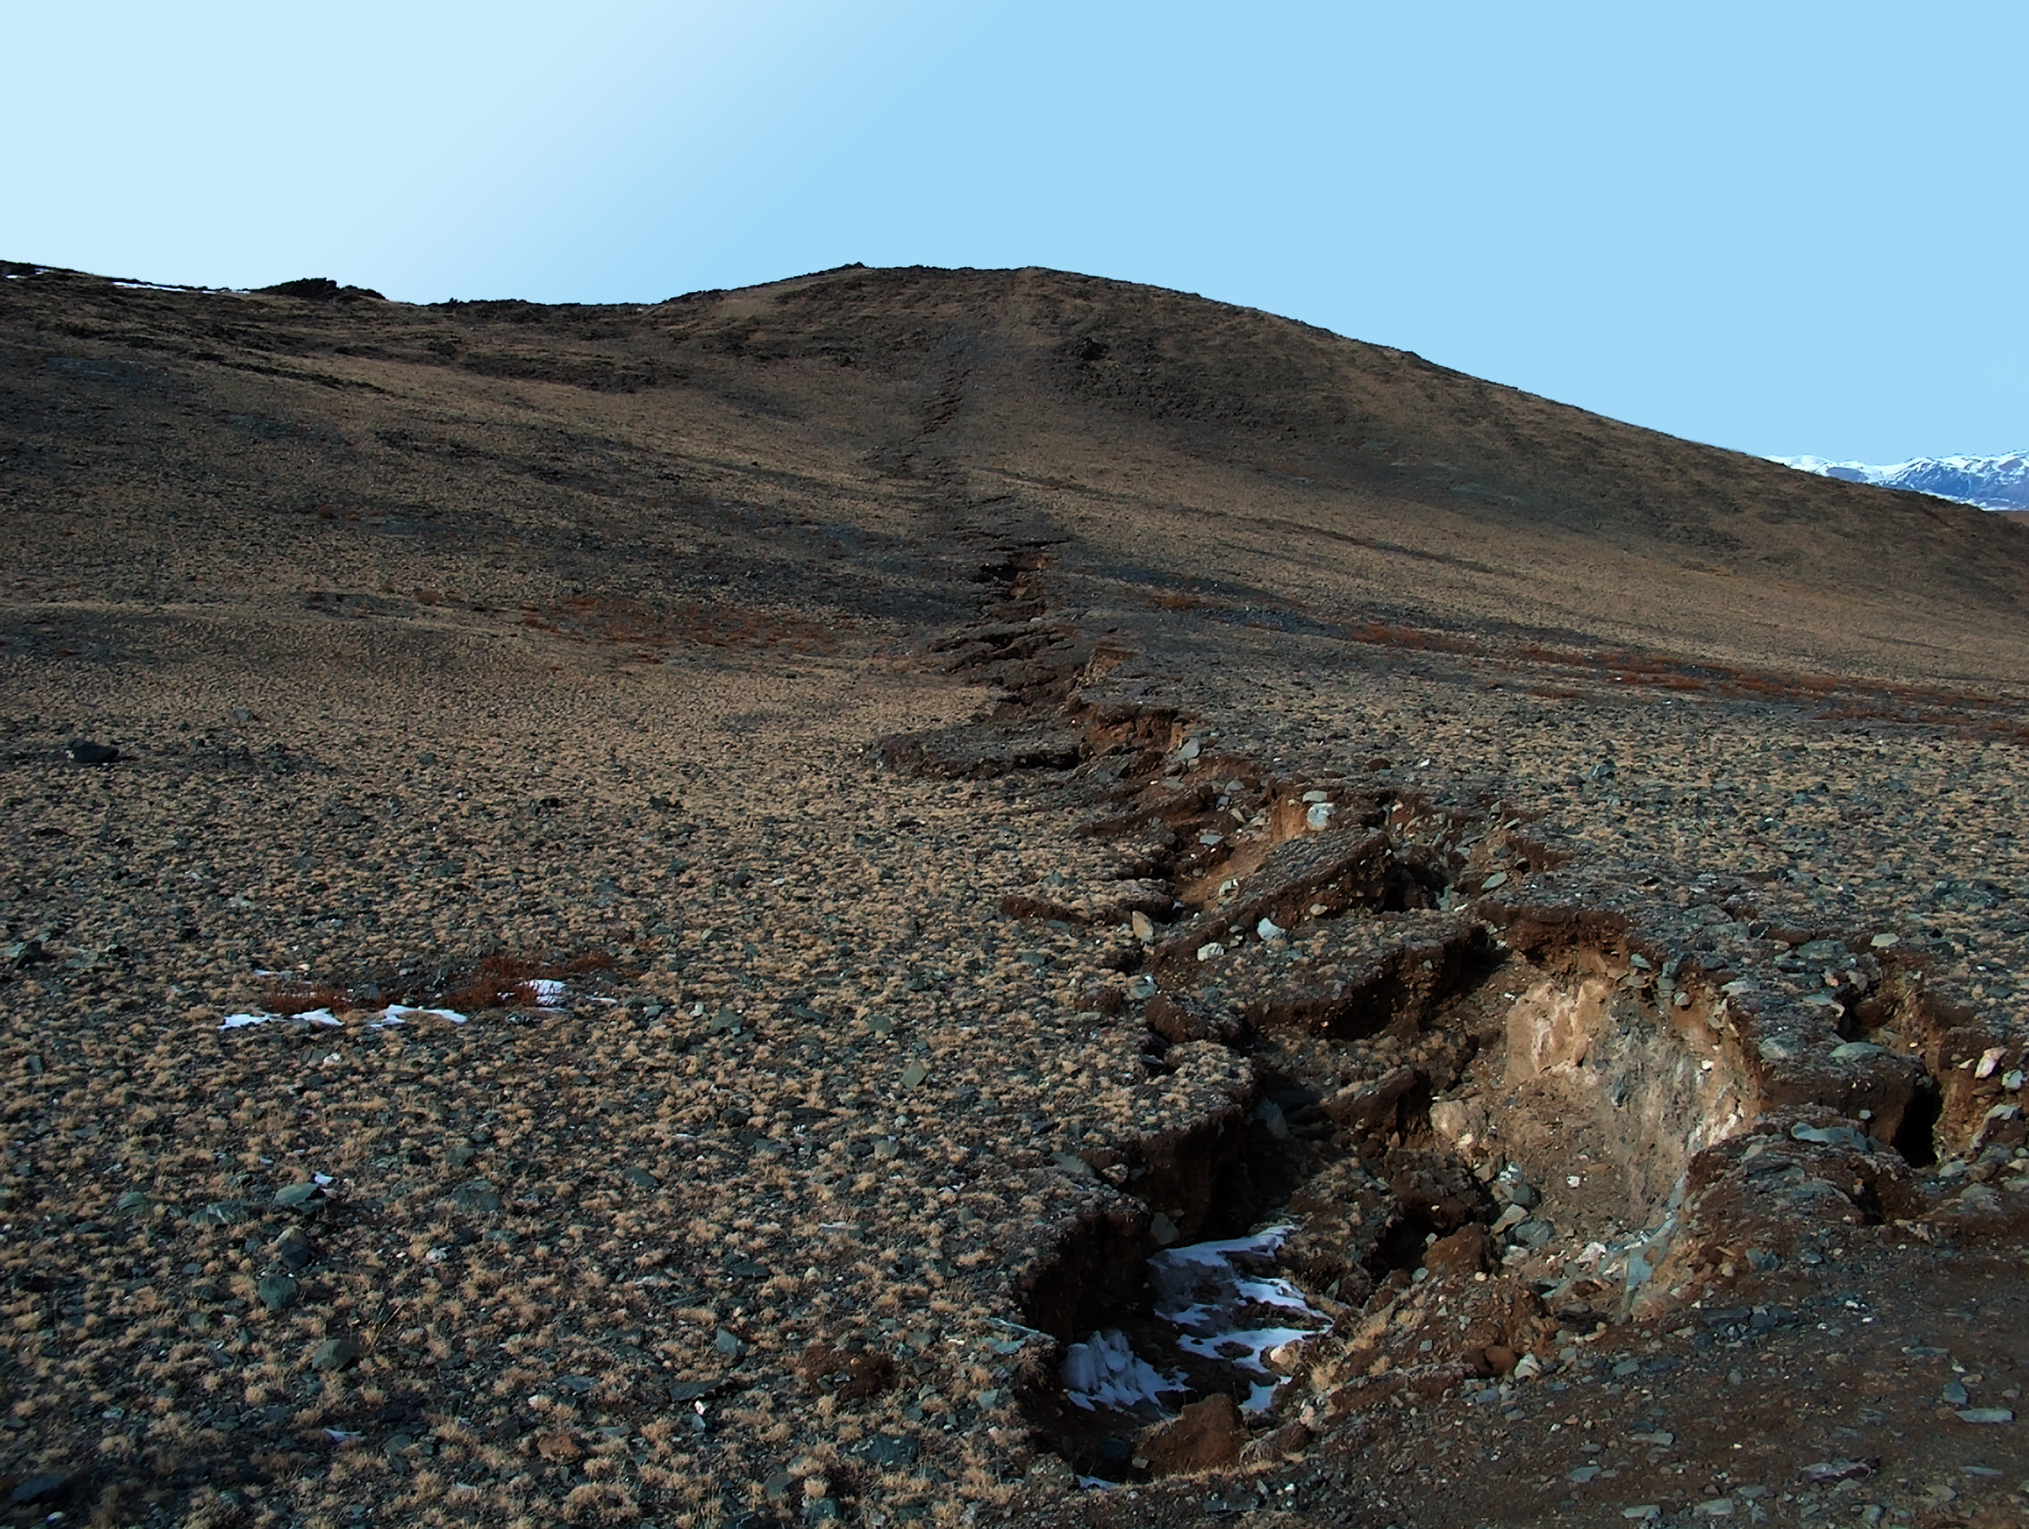
Chuy earthquake 27.09.2003 Ms= 7.3 (Mountain Altay)

Slide 6
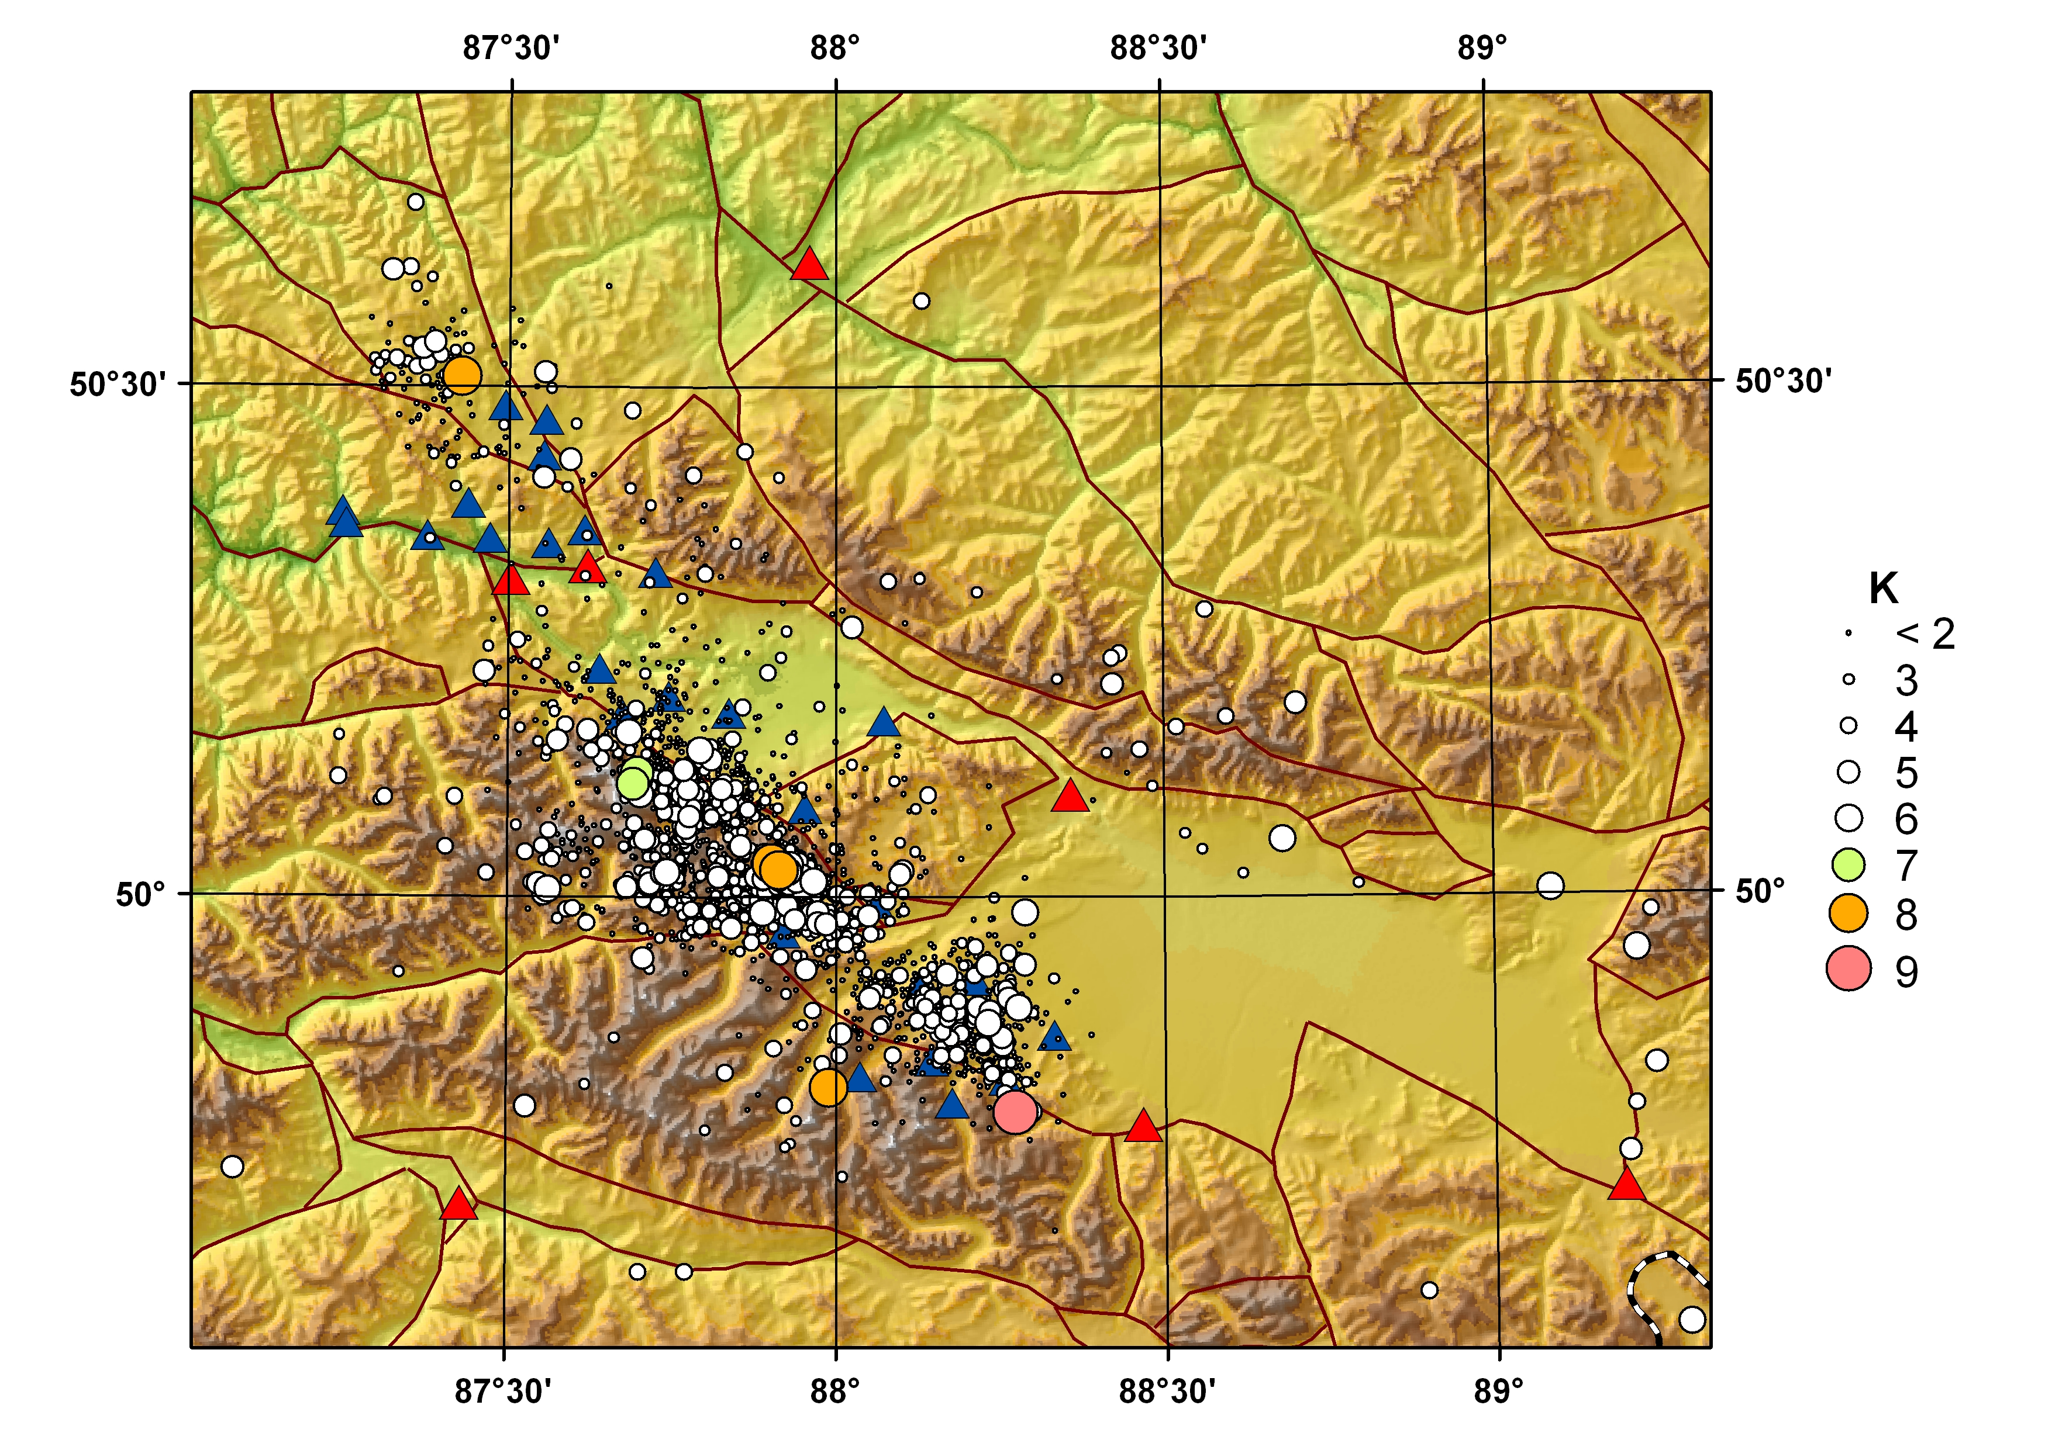
Epicentral fieldworks summer 2009

Slide 7
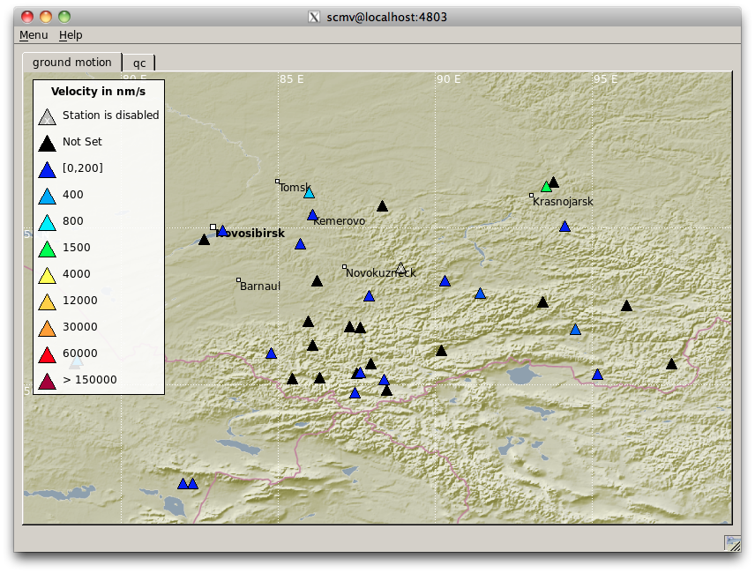
Seismic Network view from scmv window

Slide 8
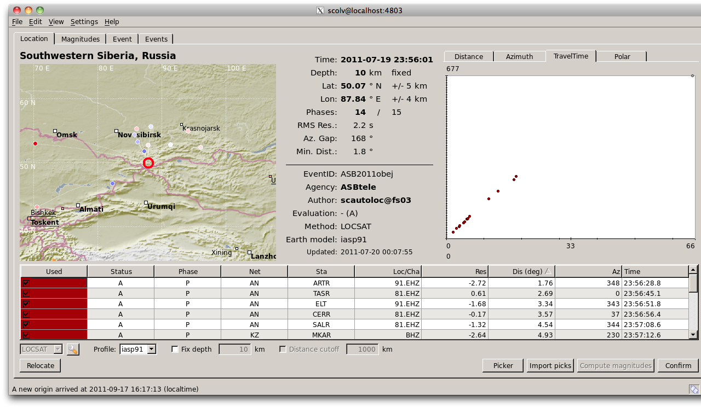

Slide 9
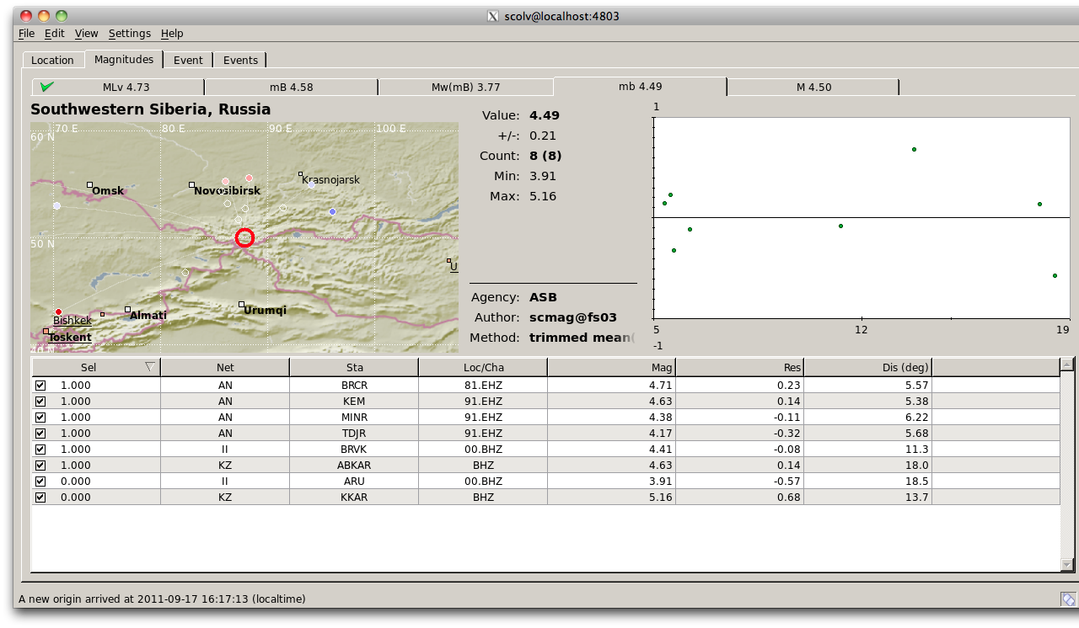

Slide 10
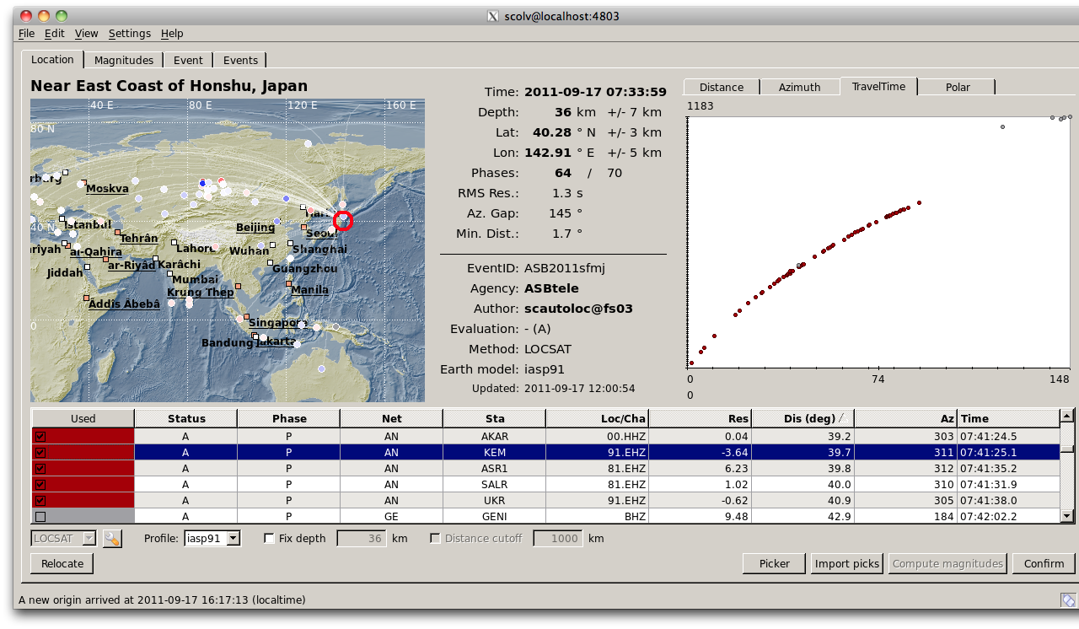

Slide 11
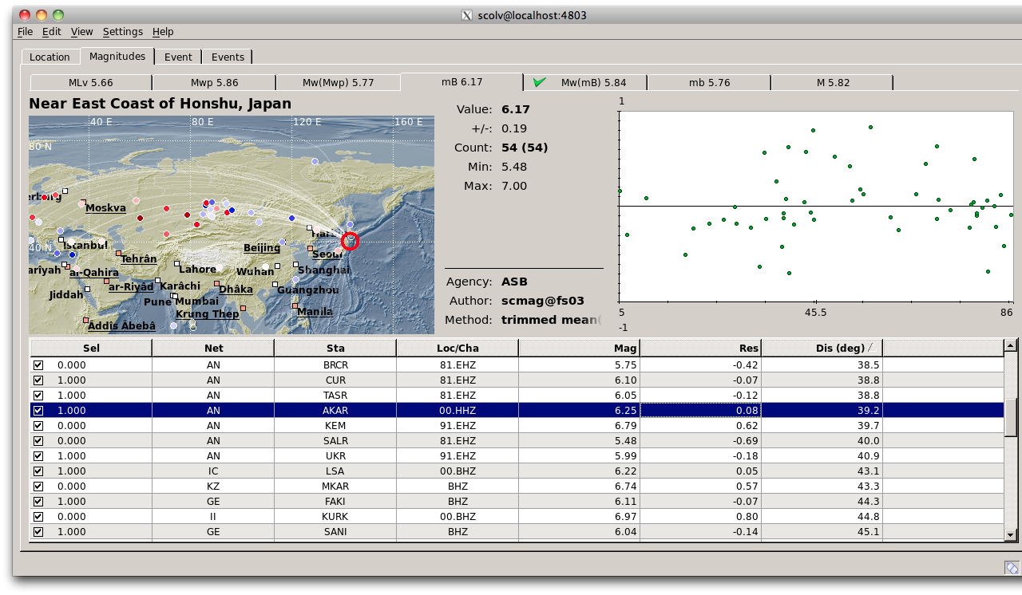

Slide 12
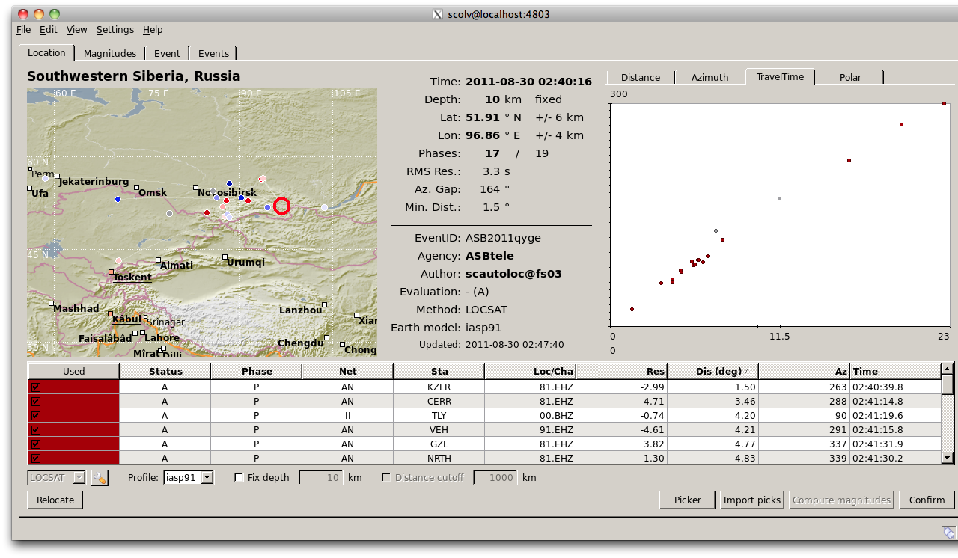

Slide 13
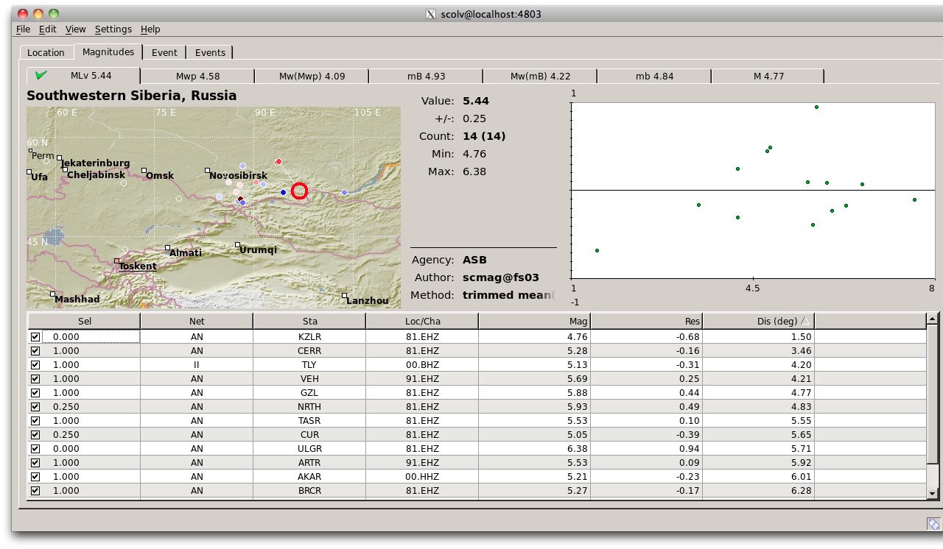

Slide 14
Digitizer Baikal-11
Has Windows recording software
We have rewrited driver for ISA board and a recorder program for FreeBSD
We have rewrite driver to loadable module and realized recording program as a seedlink plugin

Slide 15
Telemetry
VSAT links
ISDN links
GPRS links
Direct Cable Internet links

Slide 16
Quality Analysis: Archive Quality
Two level of archives A, B
A – operating level SDS structure
B – archive level SDS structure
Files transfer from A to B after rsync’ing with file from remote arcive
Archives has corresponding database schema with states and some metadata and statistics for each file in archive

Slide 17
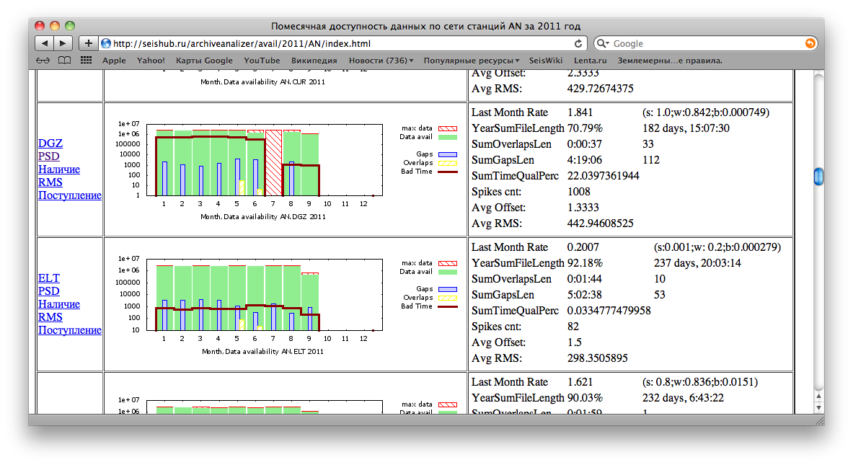
Overall Availiability Report

Slide 18
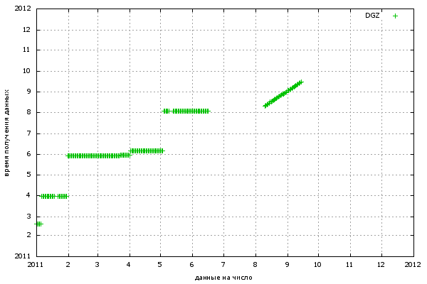
Archiving data plots (DGZ)
Date of archiving
Data avalability, Monthes

Slide 19
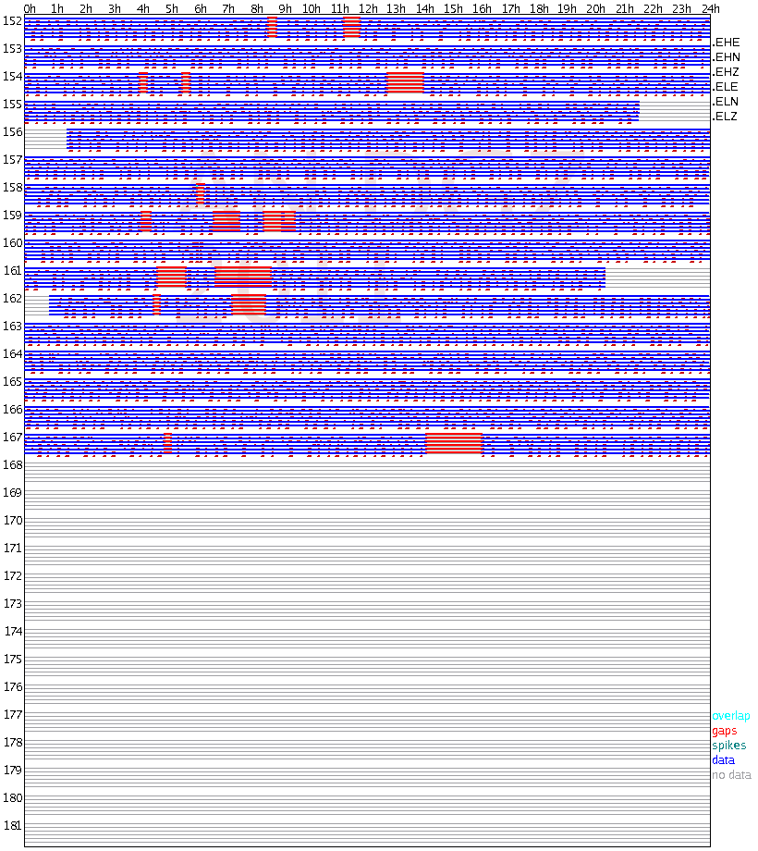
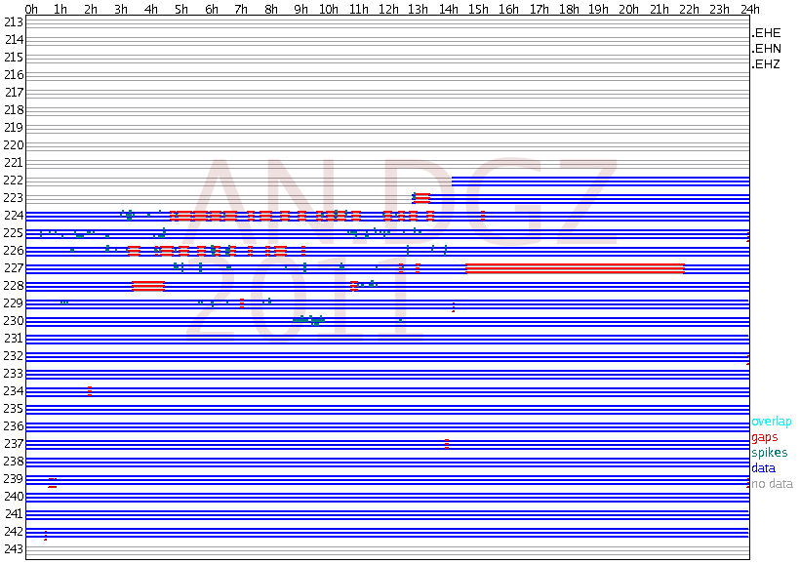
Data availiability and timing quality reports
DGZ, June
DGZ, August

Slide 20
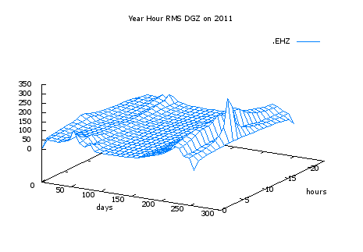
Yarly RMS Plots

Slide 21
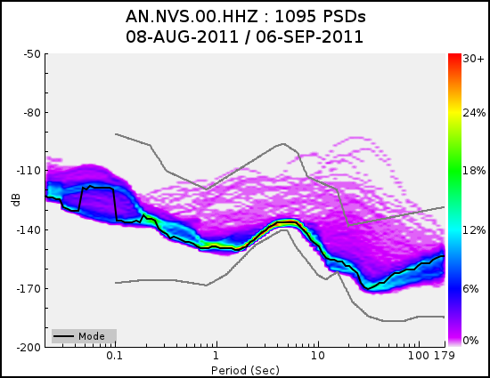
Novosibirsk HHZ, Guralp CMG-3ESPCD

Slide 22
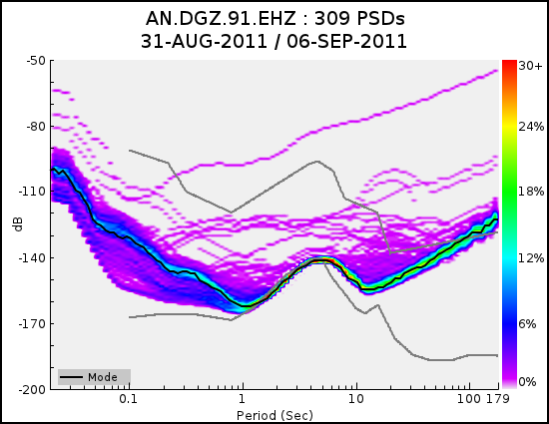
Jazzator EHZ, Kirnos SKM, Baikal-11

Slide 23
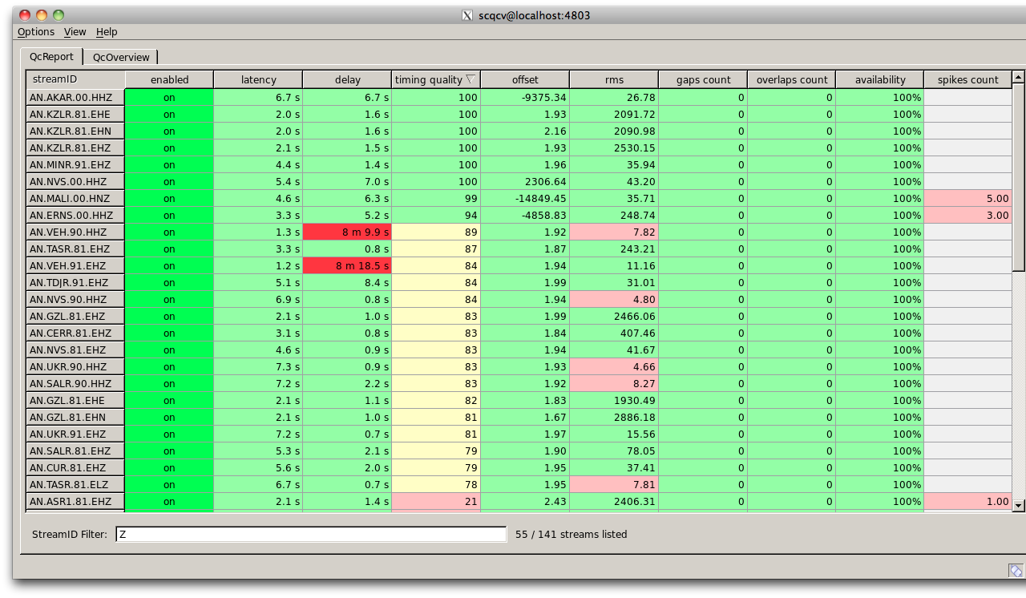
SeisComP QC

Slide 24
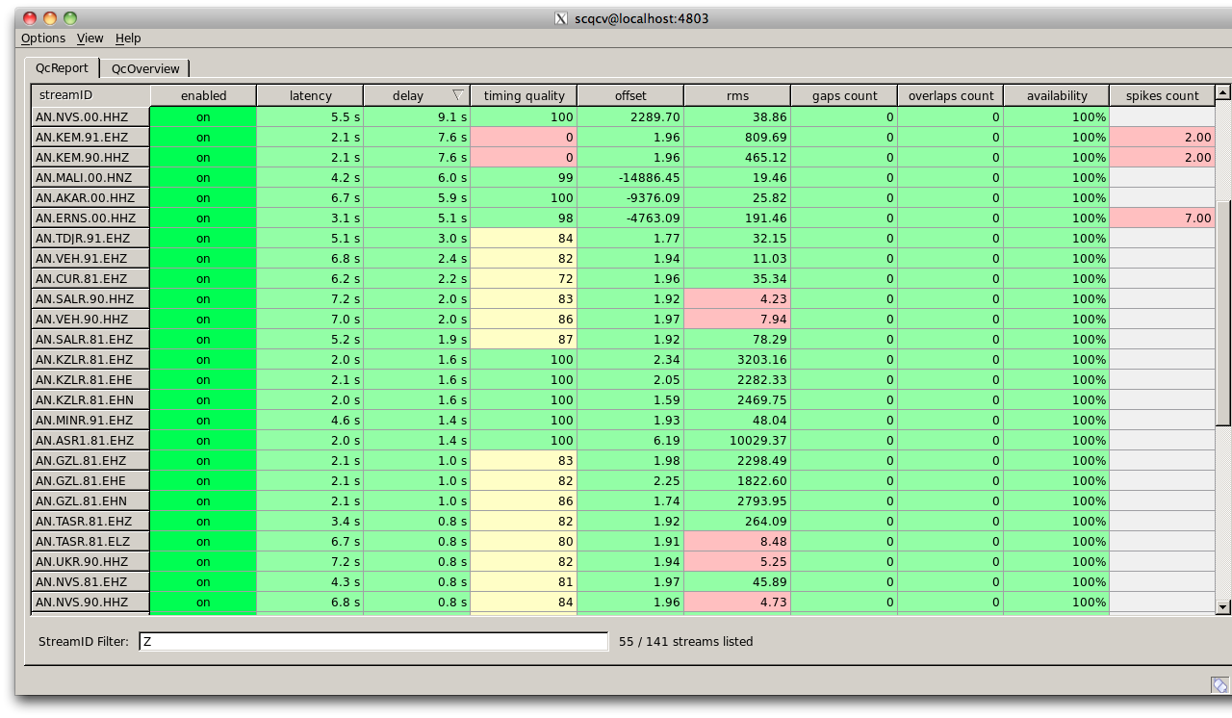
SeisComP QC

Slide 25
Monitoring Distributed Network
Monitoring of a state of communication computers is almost the same as monitoring of computer network and network ifrastructure.
There are a number of ready monitoring sollutions:
Nagios
Zabbix
OpenNMS

Slide 26
Zabbix – Open Source Monitoring Solution
Opensource
Great scalability
Web interface for configuration
Easy extendable by new data sources for monitoring

Slide 27
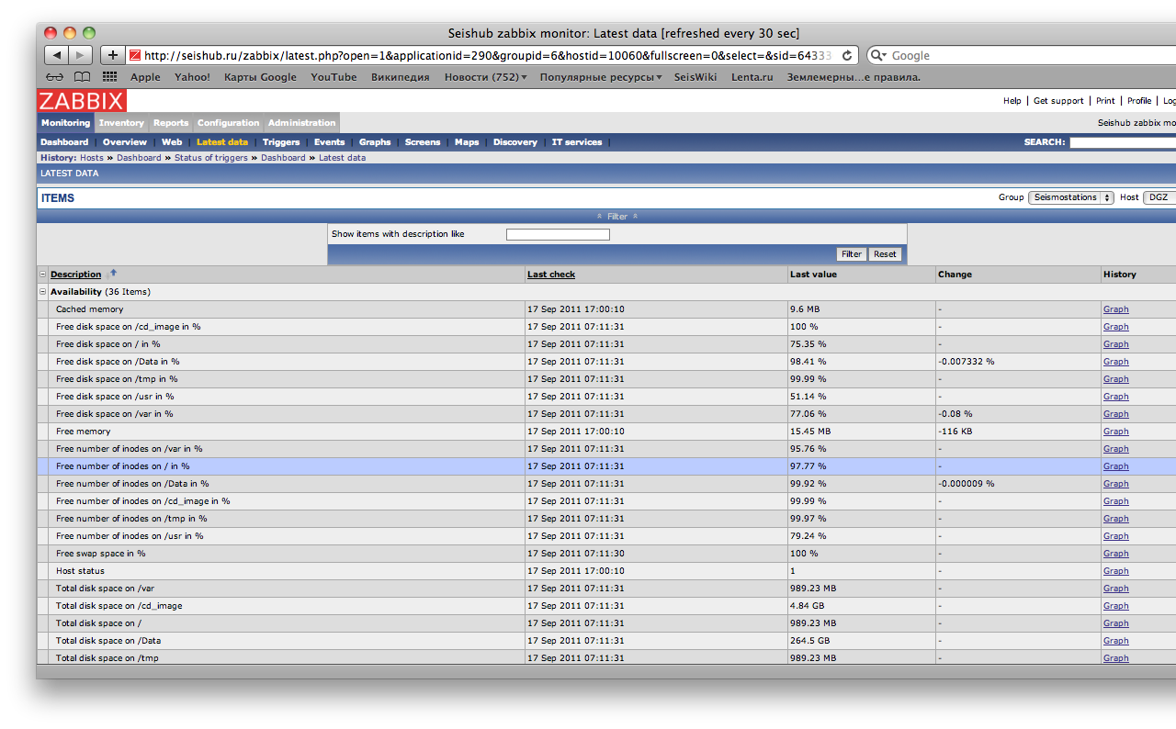
triggers

Slide 28
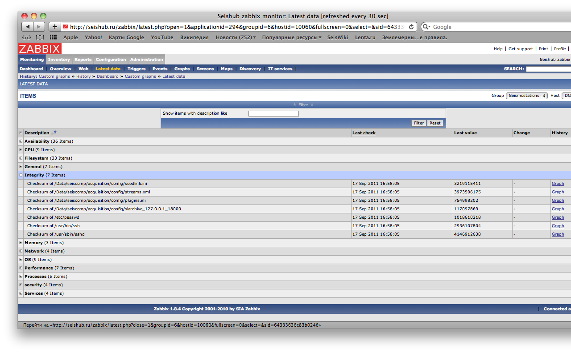
triggers

Slide 29
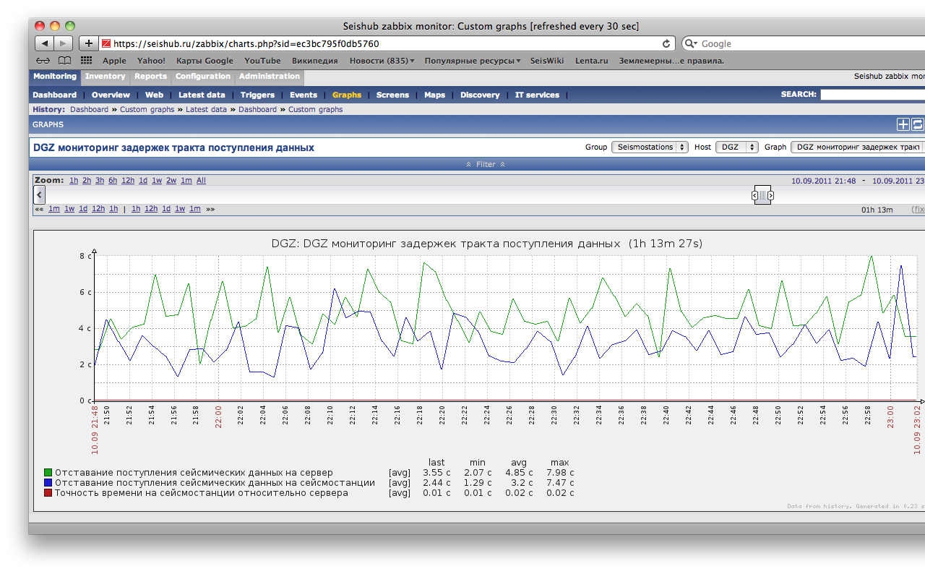
DGZ data latencies blue – on site green – at the data centre

Slide 30
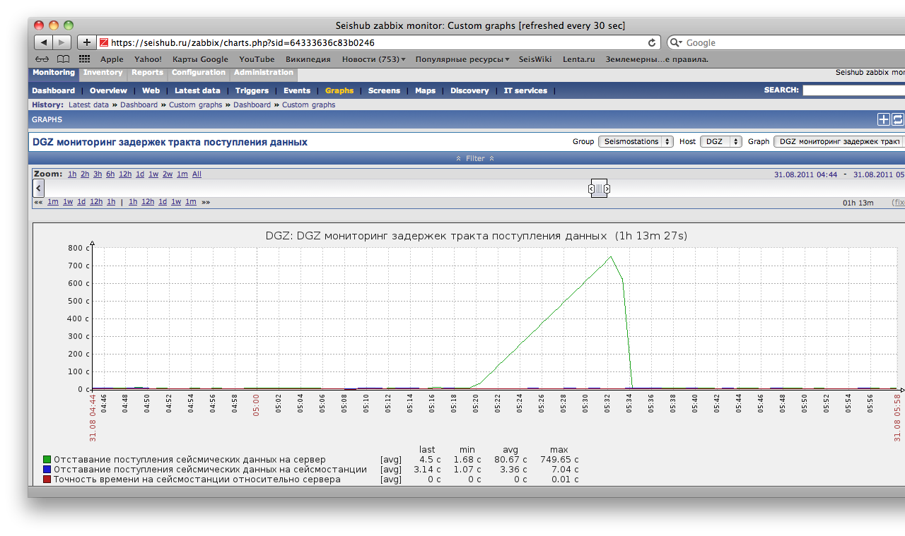
DGZ data latencies blue – on site green – at the data centre

Slide 31
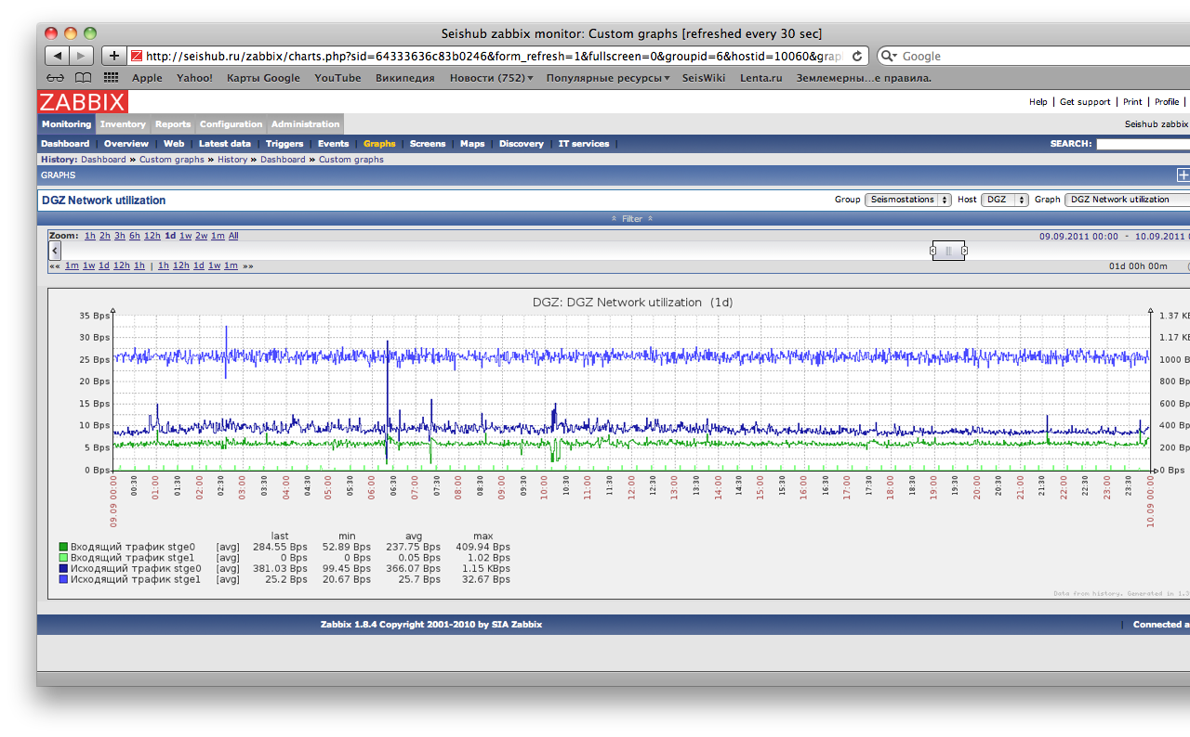
DGZ network utilization (two interfaces)

Slide 32
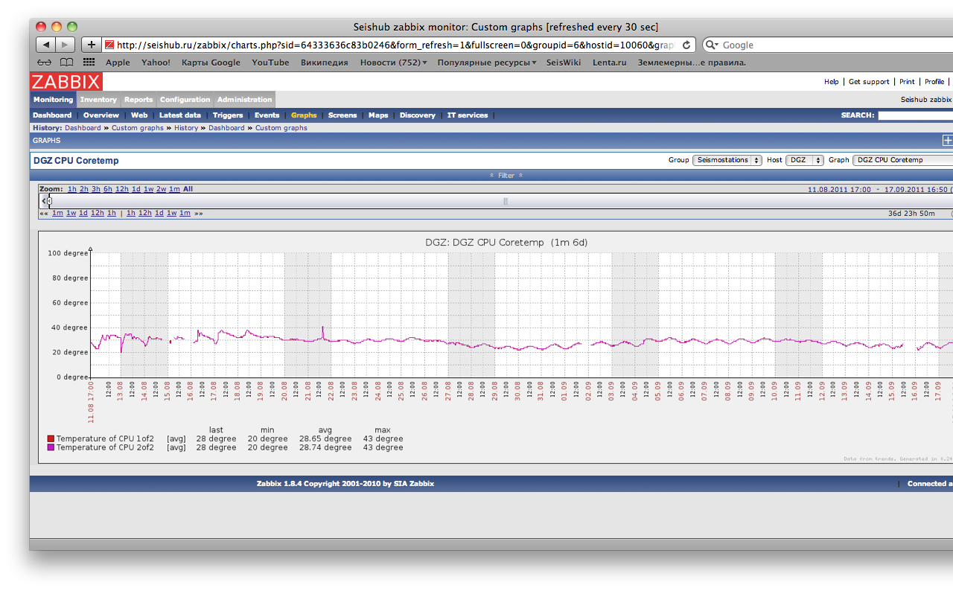
DGZ CPU core temperature

Slide 33
Realtime Spectrogramm Plotter
Based on libslink library and QT
Acquiring data from seedlink server
Uses BMP image format to allocate image only once and plot only newest available data
Uses fftw Fast Fourier library
Can be used to plot data for lots of stations

Slide 34
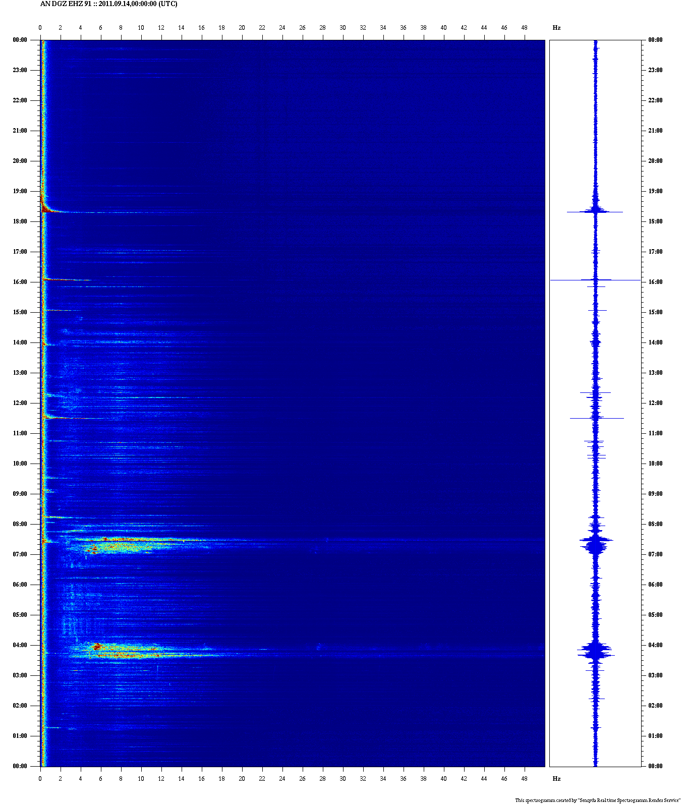
DGZ EHZ

Slide 35
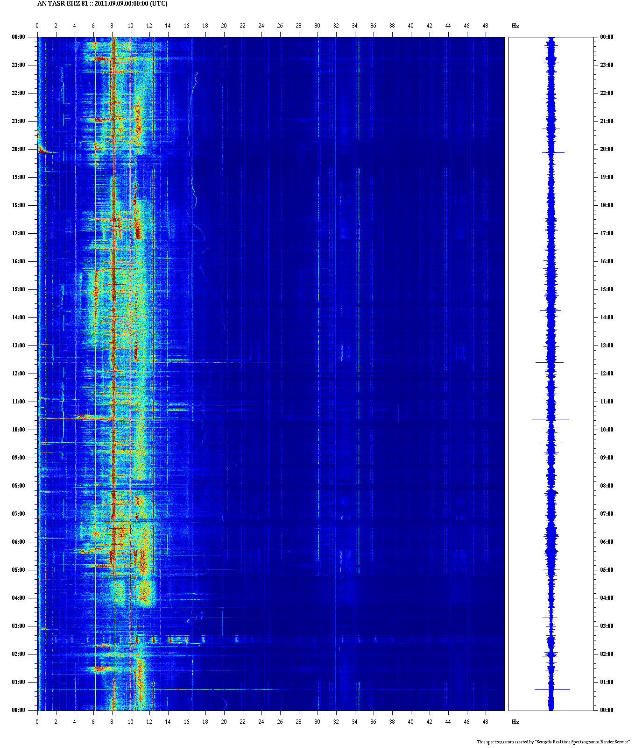
TASR EHZ
Close to mining

Slide 36
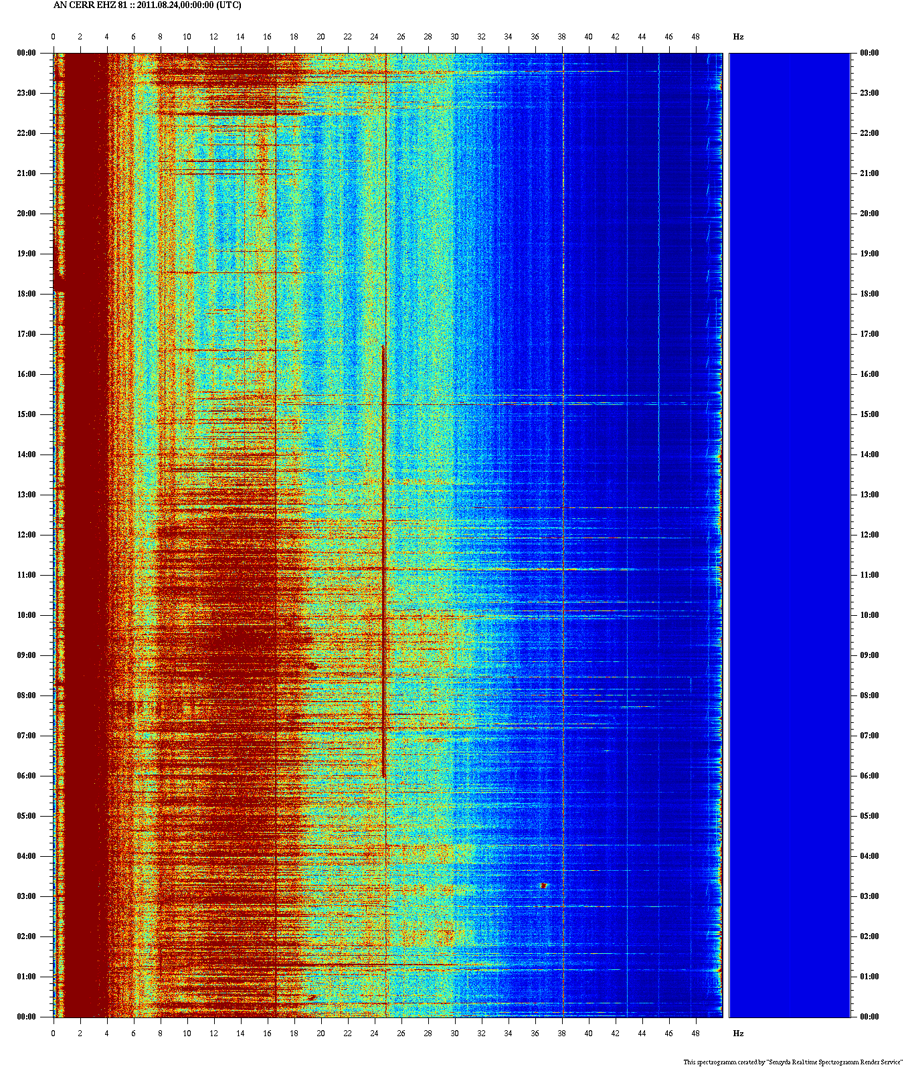
CERR EHZ
4 km to Sayano- Shushenskaya Dam hydro power plant

Slide 37
New digitizer Baikal-8
Single module with external GPS
Has an ARM board inside (no linux)
Seedlink protocol single connection supported by hardware
One prototype is ready and five in production

Slide 38
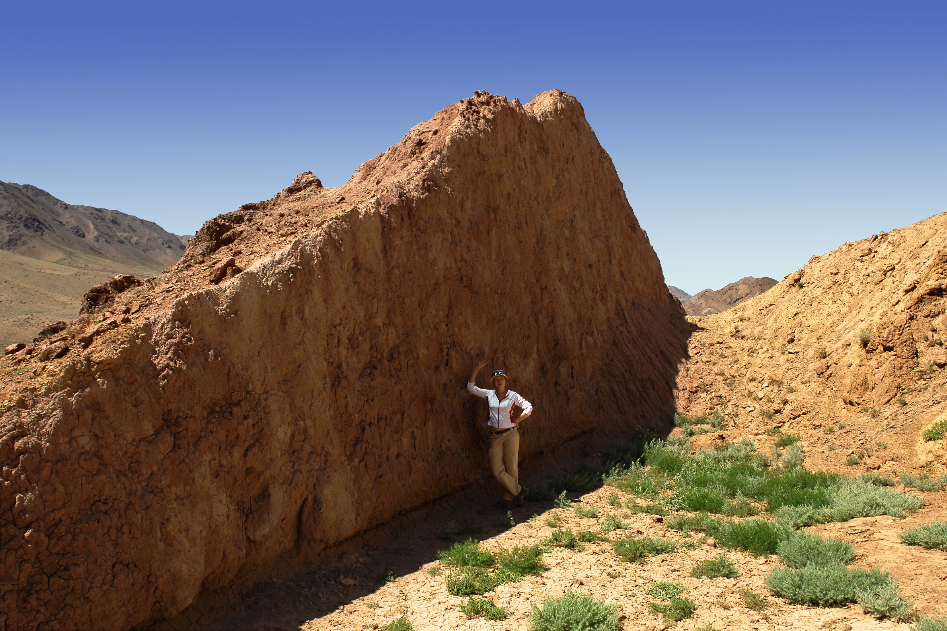
Thank YOU!

